Slide 1

Verifying the consistency of security policies across the Kubernetes Stack
Jasper Goris, Master toegepaste informatica
Promotors: Eddy Truyen, Wouter Joosen, Tobias Mühlberg
Mentor: Gerald Budigiri
Notes:
open-source system

Slide 2
Overview
Kubernetes: the basics
The 4 C’s of Kubernetes security
Importance of aligning policies: an example
NFVGuard
Kano
Microsegmentation
The thesis
Milestones and approach

Slide 3
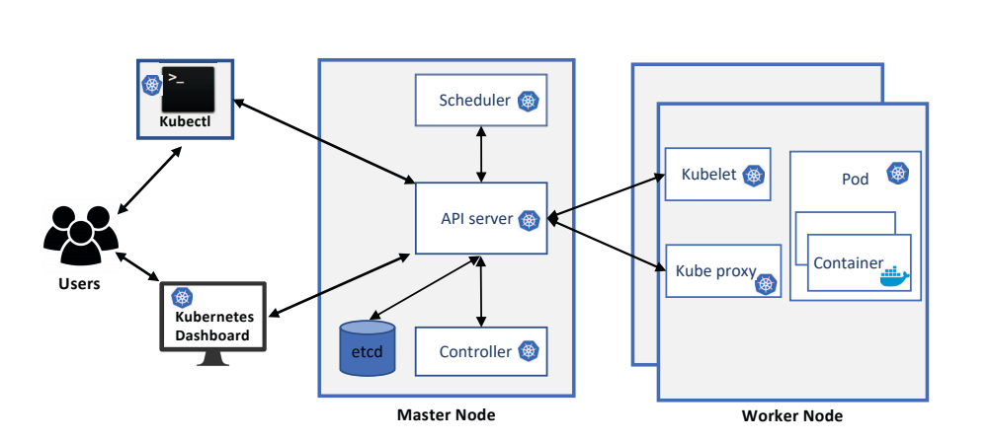
Kubernetes: the basics
Automatic deployment, scaling and management
Master node = management
Worker nodes = workhorse
Replication of nodes according to workload
Define limits for resources
Built-in load balancer
A brief overview of Kubernetes [1]
Notes:
Installation = cluster
Cluster -> nodes -> pods -> containers (Docker containers)
Api server = handles commands,
Controller = watches API server and updates states,
Scheduler = scheduling of pods on nodes
ETCD = key-value database with configurations
Kube-proxy = maintain network rules
Kubelet = ensure container running inside pods

Slide 4
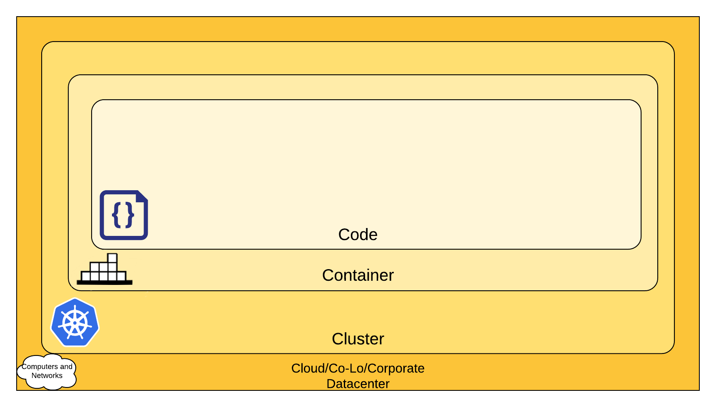
The 4 C’s of Kubernetes security
Code layer: out of scope
Container layer: application manager configures, controls and monitors applications
Policies between nodes
Cluster layer: Cluster manager installs, configures, controls and monitors K8 installation
Policies between containers
Cloud layer: Cloud manager Manages VMs
Policies between VMs
‘Multiple truths’ problem
4 C’s of Kubernetes [2]
Notes:
Example: Cloud layer: Box clusters in to minimise spread of attacks
VS Container layer: easily communicate with each other for fast response times

Slide 5
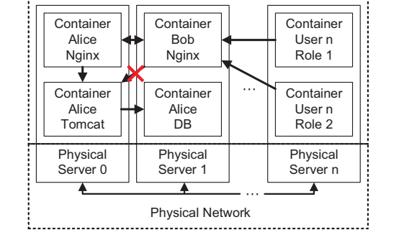
Importance of aligning policies: example Taken from the Kano research paper [3]
Bob and Alice within same cluster
Alice:
DB only trough own Tomcat
Nginx public
Tomcat only trough Nginx
Allow Nginx to Tomcat
Bob:
Nginx connects to Alice’s Tomcat
Connects to Alice’s DB
The structure of a container cluster [3]

Slide 6
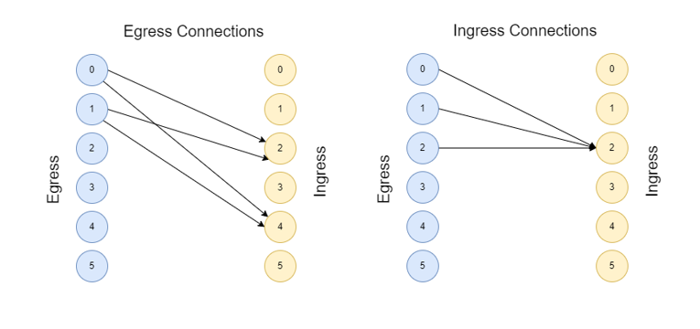
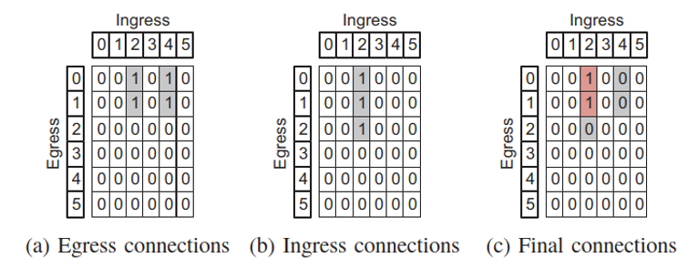
Kano 1/2
2 bipartite graphs: egress and ingress
Vertices: Containers
Edges: Policies
Transform to matrices
Create intersection: Reachability matrix
Container network reachability matrix model [3]
Notes:
4C -> Container level
2 kinds of policies

Slide 7
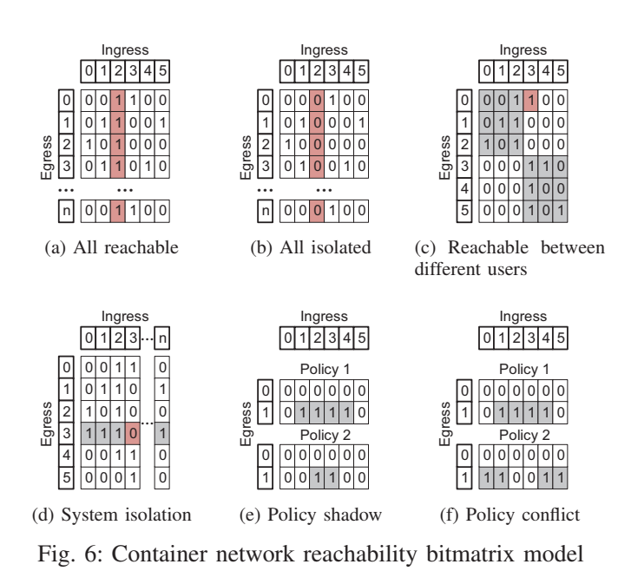
Kano 2/2
Different situations to be read:
All reachable
All isolated
Reachable between users
System isolation
Policy shadow
Policy conflict
Limited to Container level of 4 C’s
Container network reachability bitmatrix model [3]
Notes:
Policy shadow: One rule redundant
Policy conflict: Contradiction

Slide 8
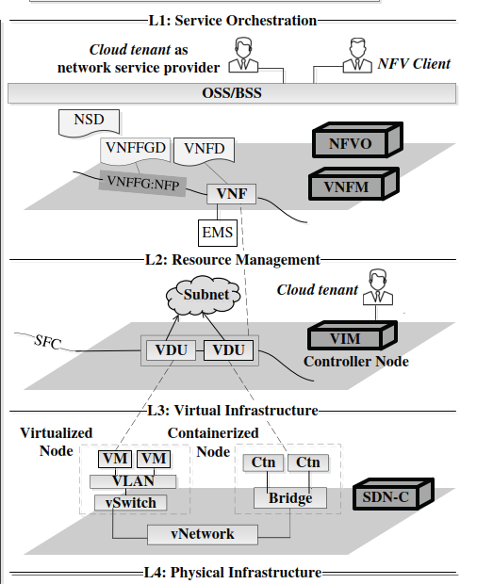
NFVGuard 1/2
NFV = Network Functions Virtualization
4 layers:
Service Orchestration
Resource Management
Virtual Infrastructure
Physical Infrastructure
Naïve solution: check all policies vs NFVGuard: Verify at own level and extend to neighbour levels
The multilevel NFV model [4]
Notes:
4C -> Cloud layer
Service Orchestration = specification and lifecycle management of network services
Resource Management = the instantiation of these services and management of resources
Virtual Infrastructure = hosts the virtual resources
Physical Infrastructure = Routers, Ethernet cables…

Slide 9
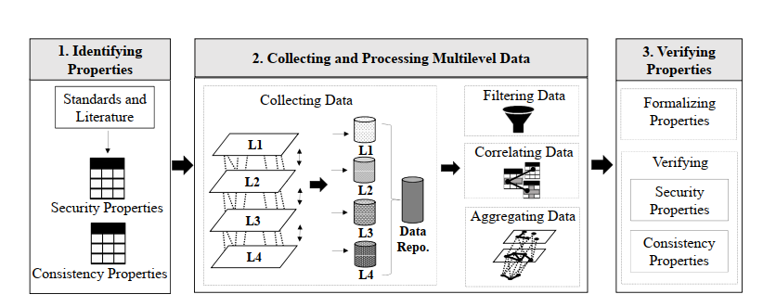
NFVGuard 2/2
Collect data
Data cleanup
Verification
An overview of the NFVGuard approach [4]
Limited to Openstack/Tacker
In the cloud layer of the 4C’s
Notes:
Data from Logs, Config files…
Verification -> CSP Solver Sugar
Security properties -> precidates
negate constraint and solve. No solution -> holds

Slide 10
Microsegmentation
Split up application into microservices
Microservices gets UID
Security policies defined with UID’s
vs
Security policies defined by IP, Ports…
Thesis will lean on the concept, but not part of it.

Slide 11
My thesis
Consistency between security policies through layers
Obstacles:
- Fluid environment
Computational overhead
Time complexity
Generic solution

Slide 12
Milestones and approach
Literature Study (Finished)
Scope definition (Current)
Define research questions and thesis title
Construct the algorithms for my solution
Time complexity benchmarks
Answer the research questions
Thesis paper

Slide 13
Step 4: Construct the algorithms for my solution
Create a list of Containers/Nodes/Security groups and the VM’s they run on
Generate inter-VM current-state reachability communication matrix by policies on cloud level
Compare Kano reachability matrix with inter-VM current-state matrix to find conflicts (traceback!)
Define events that force execution of (part of) the solutions algorithm
Code an implementation for Kubernetes and e.g. Openstack

Slide 14
Sources
[1] M. S. Islam Shamim, F. Ahamed Bhuiyan and A. Rahman, "XI Commandments of Kubernetes Security: A Systematization of Knowledge Related to Kubernetes Security Practices," 2020 IEEE Secure Development (SecDev), 2020, pp. 58-64, doi: 10.1109/SecDev45635.2020.00025.
[2] Kubernetes. “Overview of Cloud Native Security”. Kubernetes. https://kubernetes.io/docs/concepts/security/overview/ (accessed December 5, 2022)
[3] Y. Li, C. Jia, X. Hu and J. Li, "Kano: Efficient Container Network Policy Verification," 2020 IEEE Symposium on High-Performance Interconnects (HOTI), 2020, pp. 63-70, doi: 10.1109/HOTI51249.2020.00024.
[4] A. Oqaily et al., "NFVGuard: Verifying the Security of Multilevel Network Functions Virtualization (NFV) Stack," 2020 IEEE International Conference on Cloud Computing Technology and Science (CloudCom), 2020, pp. 33-40, doi: 10.1109/CloudCom49646.2020.00003.

